Slide 1
Presentation project II
Improvements and optimization of the
Digit Learning app
Thabit Hamror
02/02/2022

Slide 2
Audit
General:
Incomplete data model
Key issues for sales reps:
Time cost disproportional to basic operational needs
Manual operations
Errors and duplication
Key issues by sales directors:
Lack of reports and performance overview

Slide 3
Issues targeted by current optimization
Link between Student and Training objects
Assignment of mentors to Trainings
Automation of data update
Required fields
Validation rules
Reports and dashboards
Access features (e.g. quick actions)

Slide 4
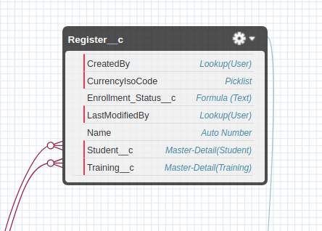
Key Improvement
Creation of junction-object: Register
Connection between the Training and Student objects addresses the question of an incomplete data model

Slide 5
Issues resolved by junction-object
Automation of student status change upon registering to training
Automation of counting down number of seats available in a training after each registration
Automatic update and display of number of trainings a student has registered

Slide 6
Reports and Dashboards
Number of available places by training type
Rate of transformation for post-optimization students
Number of student by total of trainings registered
Students by status and mentor
Training type by total of trainings open and total seats available

